Slide 1

National Cranberry Cooperative
By
Jianxiang Zhai & Apoorv Akhouri

Slide 2

Company Background
National Cranberry Cooperative –NCC
-Formed and owned by growers of cranberries
-One of the larger cooperatives
-Operations in: Massachusetts, New Jersey, Wisconsin, Washington, Oregon, British Columbia and Nova Scotia.
-Main product:
a. Fresh cranberries
b. Processed cranberries: juice, canned fruit, frozen fruit, etc.

Slide 3
The major problem
The case relates the concerns of the VP operations about NCC’s receiving plant#1 (RP1).
RP1 receives harvested berries and is opened for operation about four months a year. (early September to early December)
The plant incurred high overtime costs.
The grown-owners of the coop were frequently forced to wait long hours to unload their crops.
The capacity of containing processed fruit is insufficient.

Slide 4
Cranberry Harvest
Harvest season: September to December
RP1 is operated seven days a week
27-member work force or 53-member work force.
Plant schedule in low berry volume:
6 workers in receiving
10 workers in the milling area
8 workers in shipping
1 worker supervises and 2 workers in control room
Plant schedule in peak season:
15 workers in receiving
15 workers in milling area
20 workers in shipping
1 worker supervises and 2 workers in control room

Slide 5
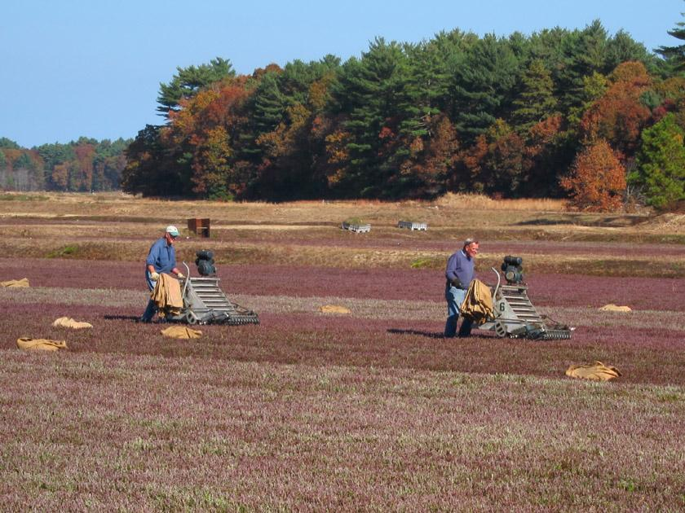
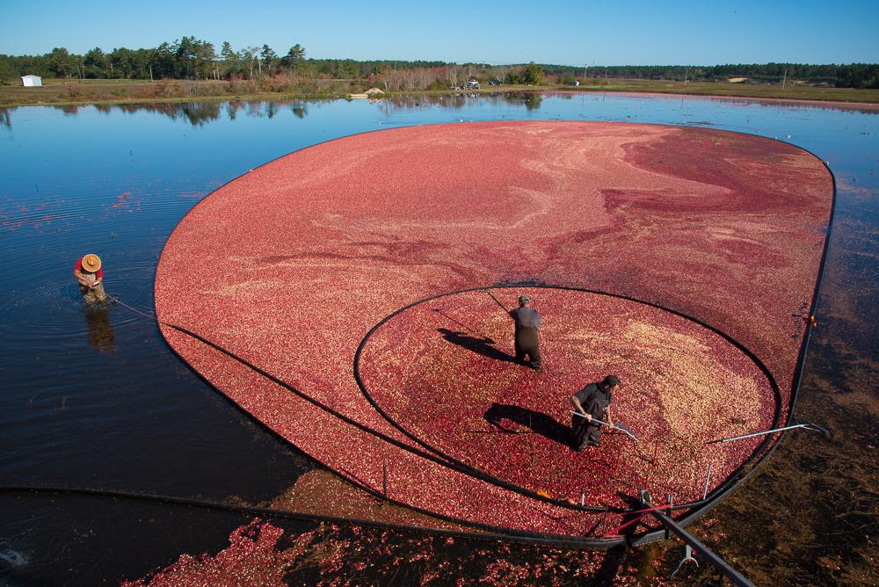
Harvest Method
Dry harvesting:
- Berries are handpicked from the bushes
Water harvesting:
- The bogs are flooded
- The berries are mechanically shaken from the bushes
- The berries are collected easily
- Yields up to 20% greater than dry harvesting
- However cause some damage and shorten the long-term storage time.

Slide 6
Cranberry processing in RP1
Berries
Dry storage bin (1-16)
4000 bbls
Destone
4500 bbls/hr
Dechaff
1500 bbls/hr
Weight & Sampling
Truck Queue
Dumping
450bbl./hr. each
Waste
12.3%
Jumbo separator
1200 bbls/hr
Wet storage bin (17-24 + 25-27)
3200 bbls
Dechaff
3000 bbls/hr
Dryers
600 bbls/hr
Bagging stations
667 bbls./hr.
Shipping
Bulk Truck stations
2000 bbls./hr.
Bulk Bin stations
800 bbls./hr.

Slide 7
Process Fruit Receiving in RP1
Bulk trucks carrying process berries arrive
(from 20~400bbls., 75bbls. on average)
Berries are weighted and taken as a sample of about 30bbls.
The truckload of berries was graded according to the color.
From poorest(NO.1) to best(NO.3)

Slide 8
Temporary holding
Processed berries
Temporary holding Bins 1-16
(Dry only)
Bins 17-24
(Wet/dry)
250bbls. of berries each,
6000bbls. In total
Temporary holding Bins 25-27
(Wet only)
400bbls. of berries each
1200bbls. In total
Mean conflict
A bottleneck in the process flow – the long truck queues waiting to unload the berries.

Slide 9
Scheduling the work force
If a 11 hour work day is assumed on a peak day, RP1 must process ~1200 wel barrels/hr on a peak day.
Bottleneck in the system at the drying units:
only 600bbls./hr can be processed through the dryers in an eight-hour work-day
only 4800bbls. of wet berries can pass through the system.
70% of the berries entering the system are wet berries.
On an average day, over 10,000 bbls of cranberries are dried at the plant.
It will take 11.7hrs to process the berries at 600bbls/hr.
Approximately 3.7 hours of overtime created for each member of the crew on each average working day.

Slide 10
Scheduling the work force
Also, queuing of trucks,
Peak Day ➡️ 19,000bbls
Dryers must work:
19000 / 600 x 0.7 = 22.2 hrs, to process all the wet berries.
If the plant runs for 11 hours on a peak day,
19000 / 11 x 0.7 = 1209 bbls/hr, should be processed.
The lack of drying capacity:
the maximize capacity of the wet holding bins is only 3200bbls.
Thus, bins fill up in 5.25hrs & post that, trucks start
to queue up rapidly
Thus, inventory keeps building up at a rate of,
1209 - 600 = 609 bbls/hr
🏭 🚚 🚚 🚚 🚚 🚚 🚚 🚚 🚚 🚚 🚚 🚚

Slide 11
Current Scenario
Adding 1 Extra Dryer
Adding 2 Extra Dryers
The 2nd dryer will not prove to be very effective as milling area becomes the bottleneck in this scenario since only 1200bbls/hr of both dry & wet cranberries can be processed through the separators.
Although, 1 extra dryer does end up saving the company 2.85hrs.
Input Rate per Day | Hours
10k | 11.6
15k | 17.5
20k | 23.3
Input Rate per Day | Hours
10k | 8.75
15k | 13.3
20k | 17.5
Input Rate per Day | Hours
10k | 8.3
15k | 12.5
20k | 16.7

Slide 12
Total savings in these 45 probable peak days would be:
2.85 hrs x 20 labourers x $2.25 wage rate x 1.5 overtime x 45 days = $8,657
which is ~25% ROI from the $25000 cost of adding a new dryer.
Also,
Queue reduced to 40 trucks at EOD with the last truck having a waiting period of 3.7hrs.
Meanwhile, NCC will have to convert 12 dry bins to those that can be used for both dry & wet bins,
∴ 12 x $5000 (cost of converting 1 bin) = $60,000 additional cost
From simulations we notice,
to avoid truck queueing fully ➡️ 2nd dryer should be bought.
Also,
4 new wet bins should be bought for $20,000
rather than converting 12 bins for $60,000.
1st dryer for labour savings
2nd dryer to give better service to growers
Question:
Whether better service to growers is worth $45k or not
[$25k for dryer + $20k for 4 new wet bins]
Further Issues:
↳ Current berry grading system is inefficient
↳ Misgraded #3 berries cost the coop $112,500 annually.
Light meter system is found to be a viable option.
If 2 new dryers are added, the queue is reduced to 11 at EOD, with the last truck waiting for 45 mins.
To remove the queue fully, 4 more bins will have to be converted,
∴ $20,000 additional cost of conversion

Slide 13
Labour Costing
Single Shift -> 8hrs
Single Shift labour cost -> 20 workers x $2.25/hr x 8hrs = $360/day
∴Two Shifts -> 16hrs at $720/day
If z is the number of hrs workers have worked overtime,
Single shift + overtime -> $360 + 20 x $2.25 x 1.5 x z = $720
z = 5.3hrs
Thus, a second shift is cheaper than overtime when ever more than 5.3hrs of overtime is expected to be required. (i.e. arrival of more than 15k bbls/day)
Although, the chances of the above happening are so few that it is more practical to have an overtime rather than a second shift. Specially when finding workers for a second shift is an added task.
A second shift is only feasible when 13.3 hrs of labour is required OR when 15k bbls or more berries are anticipated to arrive at RP1.

Slide 14
Conclusion
On new equipment:
1 extra dryers will save the company up to 2.85hrs, which equals 8657$.
2 extra dryers can indeed save time but with a low efficiency. It can be added in combination of extra bins in consider of giving a better service.
4 extra wet holding bins should be bought rather than converting current bins.
On labor cost:
A second shift is better than working overtime in peak season of the harvest time.
Work overtime is more practical than getting second-shift workers.
To have an overtime rather than have a second shift can ease the problem on most of the time. NCC should adjust the labor on the basis of harvest season time.

Slide 15
Potential solution
Install one new dryers and add more wet holding bins.
Convert the storage bins to support more wet berries.
Start a second-shift working group on peak days.
Start the crew at an earlier hour on peak days.
Have a truck schedule for deliveries.
Install a berry grader instead of processing with multiple grading steps.

Slide 16
Thank you

